Slide 1
Hermes Might

Slide 2
Group Members
Sajid Mahmud Borshon - 1510947642
Mousumi Akter - 1411156642
Kazi Mohammed Sakib- 1510964042

Slide 3
Introduction
Hermes Might is a web based software solution where a user can rent playgrounds in different area in the city. It allows users to look for playground where they can arrange sports tournaments, can rent for play or they can find other people who want to play and volunteers can help the distressed people in case of natural disaster or take part in other social activities.

Slide 4

Logo

Slide 5
Software Development Model
We’ve decided to use Incremental build model to develop this software. The incremental build model is a method of software development where the product is designed, implemented and tested incrementally (a little more is added each time) until the product is finished. Why we use this model will be described at length in the following presentation.

Slide 6
Why Incremental Model?
Incremental model combines the elements of the waterfall model with the iterative philosophy of prototyping which makes it perfect for our project. One of the main benefit of this model is that we work in iterations so we can develop this project part by part and add the core functionalities faster and even if changes are required in any durations it can be easily found and fixed by regression testing. If we need to add any other core functionality it can also be put in an iteration and prioritize more.

Slide 7
Why Incremental Model?
We can create partial system to produce the final system which will make it easier. It is generally easier to test and debug than other methods of software development because relatively smaller changes are made during each iteration. This allows for more targeted and rigorous testing of each element within the overall product.

Slide 8
Why Incremental Model?
Since the initial product delivery is faster and cost less we can release the product for review and make any useful or needed changes if required.

Slide 9
Incremental Model vs Other Models
We think incremental model is best for our web application. As we are developing this web application as new developers, it will be very helpful for us to do it part by part. Using waterfall model will be a hassle for us, as it requires all the information at once and will need to integrate all things at once.

Slide 10
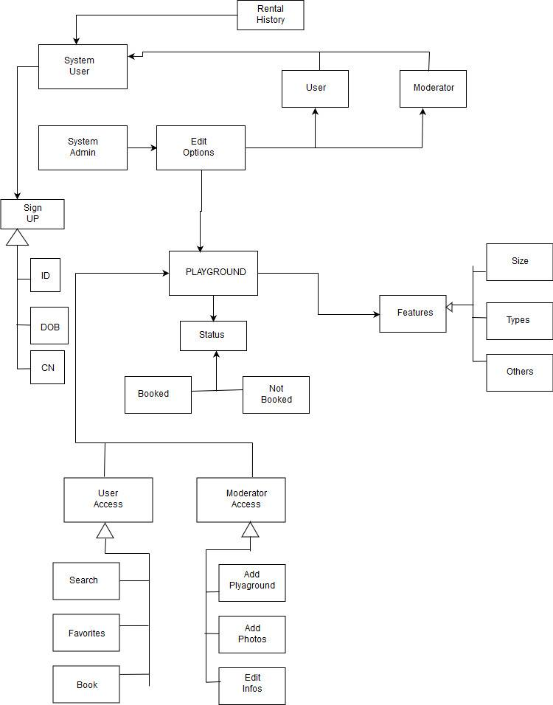
Model Class Diagram

Slide 11
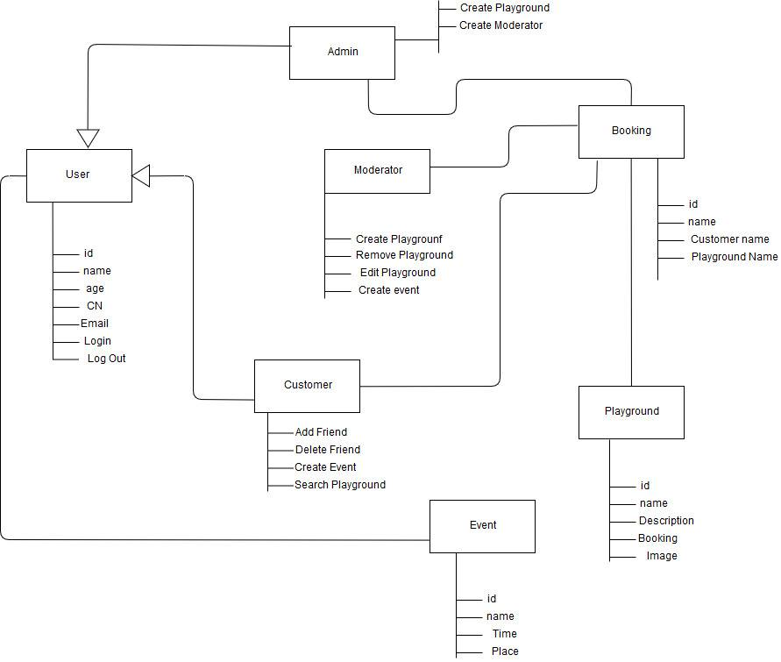
Uml Class Diagram

Slide 12
What’s in the frontend?
To give the user friendly and attractive interface we’ve used
Html5
Css3
Bootstrap
Javascript

Slide 13
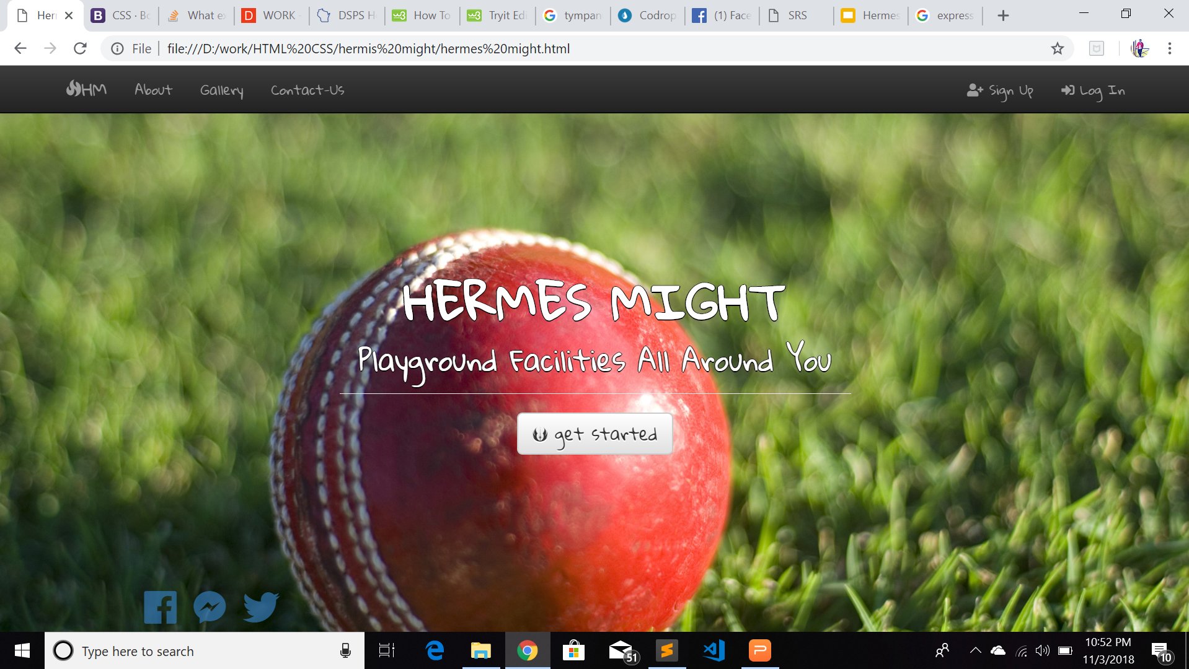
Design

Slide 14
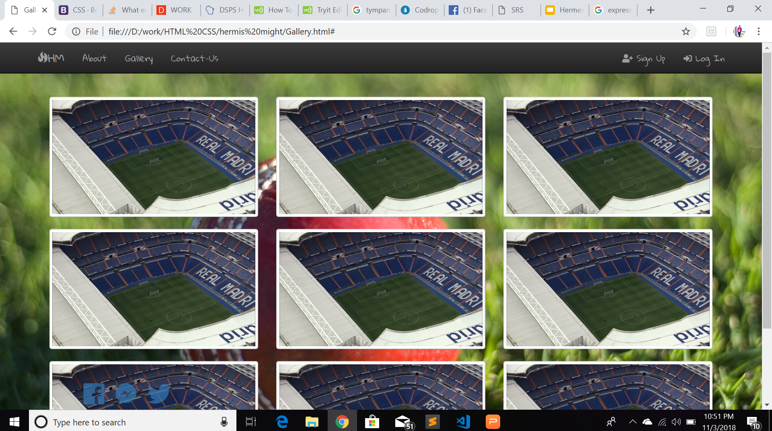
Design

Slide 15
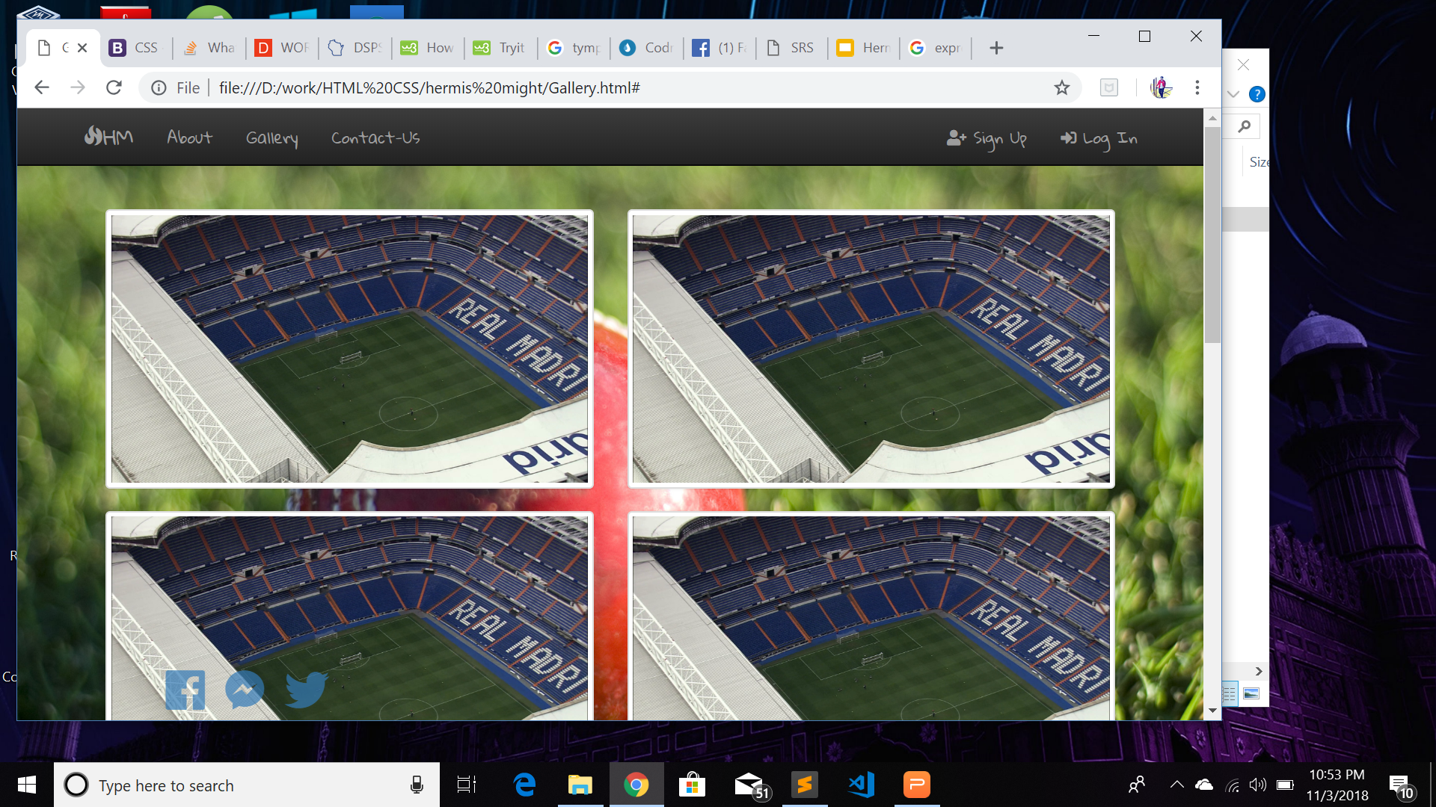
Design

Slide 16
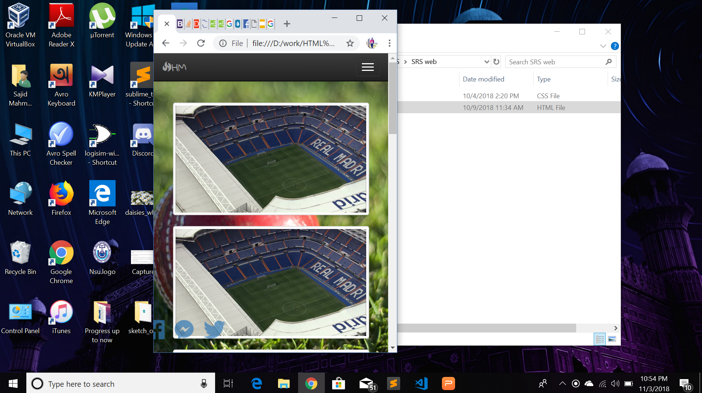
Design

Slide 17
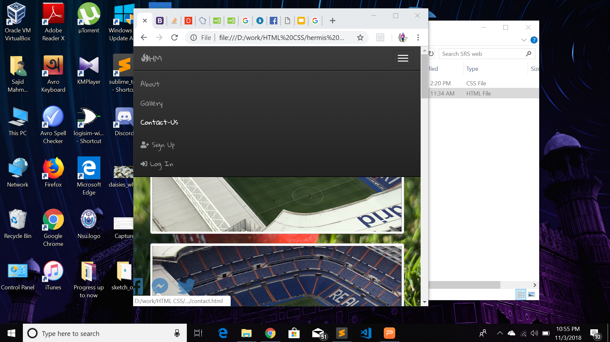
Design

Slide 18
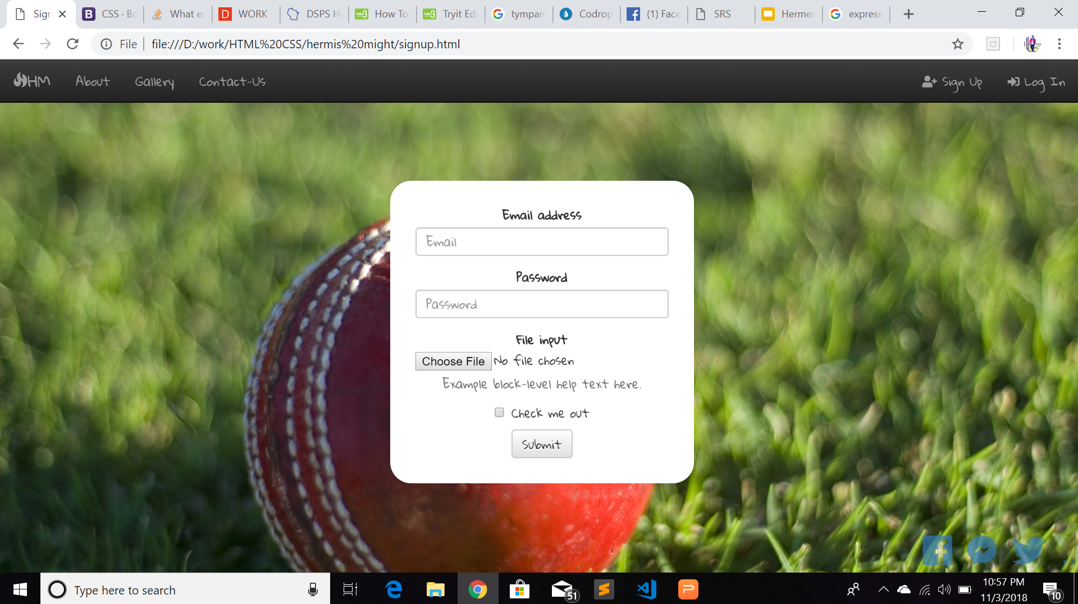
Design

Slide 19
What’s in the backend?
We’ll be using :
Node js
Express Framework
mongoDB
We haven’t integrated the backend part yet.

Slide 20
Why Node js?
Node.js uses an event-driven, non-blocking I/O model that makes it lightweight and efficient, perfect for data-intensive real-time applications that run across distributed devices.

Slide 21
Why Express Framework?
Express is a minimal and flexible Node.js web application framework that provides a robust set of features for web and mobile applications. Creating a robust API is quick and easy. Express provides a thin layer of fundamental web application features.

Slide 22
Why nosql?
We’ll be using mongoDB for Database Management System. SQL databases are primarily called as Relational Databases (RDBMS), whereas NoSQL database are primarily called as non-relational or distributed database. SQL databases have predefined schema whereas NoSQL databases have dynamic schema for unstructured data.

Slide 23
Conclusion
We will also be following various standard rules like, SOLID, DRY, KISS, YAGNI etc. So we think, by following those structures we can hope to have a good designed and also well built web application(Hermes Might).
Thank You

